Slide 1
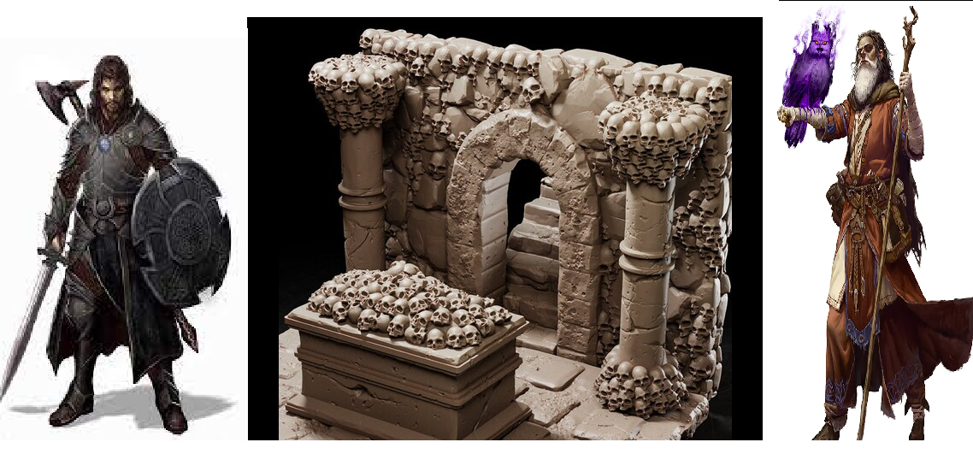
The Adventure of Salvatore
Pitch Date: October 22, 2023 Update November 26, 2023
Release Date: March 3, 2024 Commits: 69 (+12)
Team Lead: Vince McKeown 6 Contributors
1
2
3
4
5
6
7
8
9
10
11
12
13
14
15
16
17
18
19
23
30
39
57
69

Slide 2
Contributions This week -Vince McKeown
User Interface

Slide 3
Contributions This week -Patrick McKeown
Background Music

Slide 4
Contributions This week -Michael Fewkes
Improved Z-Sorting

